Slide 1
TUMMY TIME MATTRESS
FOR BABIES WITH ABDOMINAL DEFECT
FRIDAY SLIDES

Slide 2
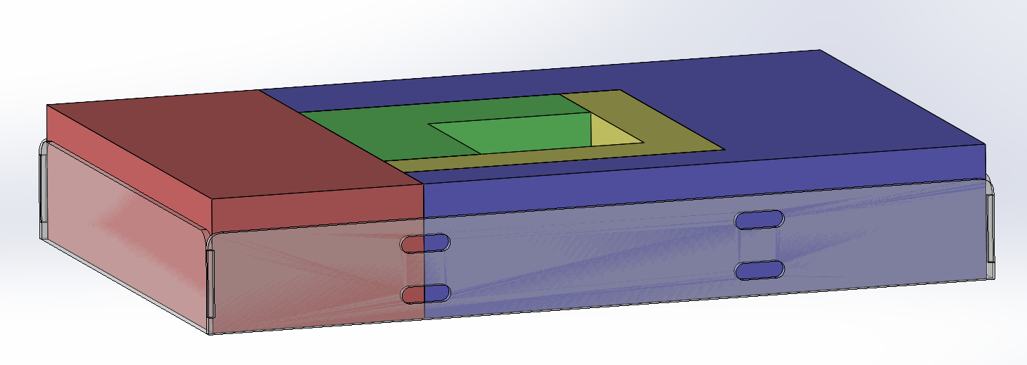
NOAM’S EDIT SUGGESTIONS
2 slits instead of 1 (straps loops onto middle part of frame)
Increased thickness from 1/16 -> 3/16
Method: still laser cutting @ UCI
Assembly: Acrylic cement

Slide 3
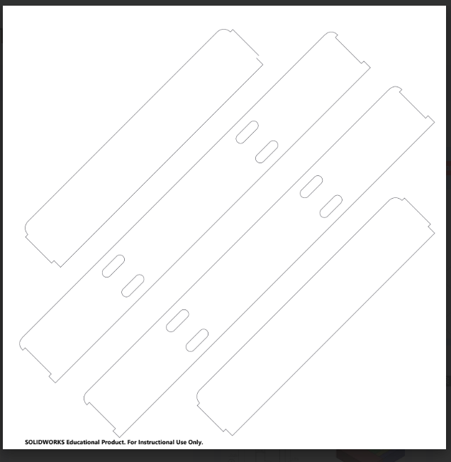
LASER CUT PATTERN (24in x 24in)
(NO
BOTTOM
BASE)
Notes:
SHOULD include in final version

Slide 4
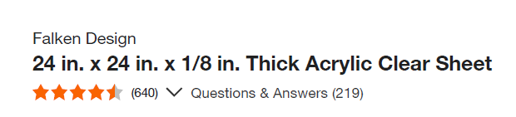
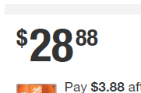
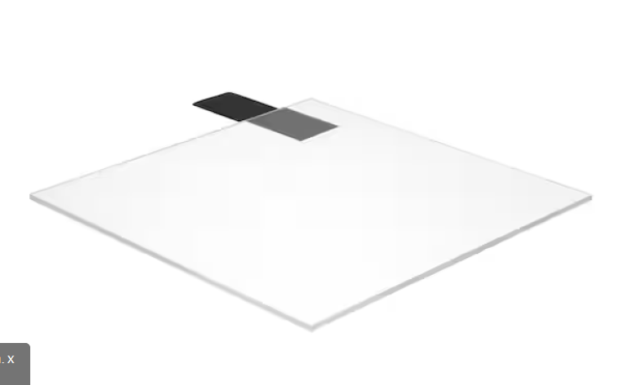
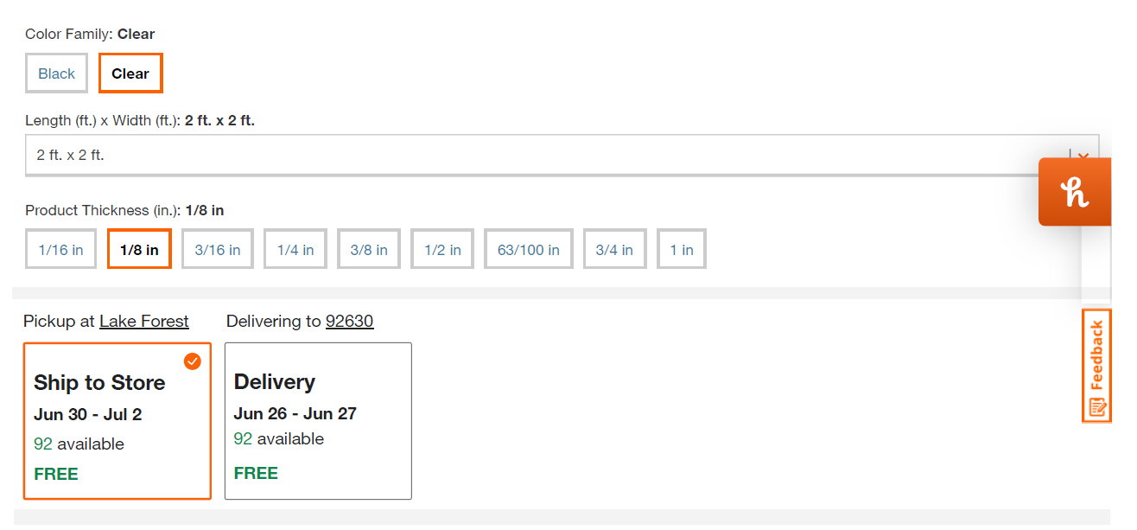
LINK

Slide 5
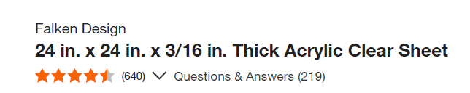
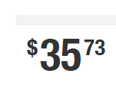
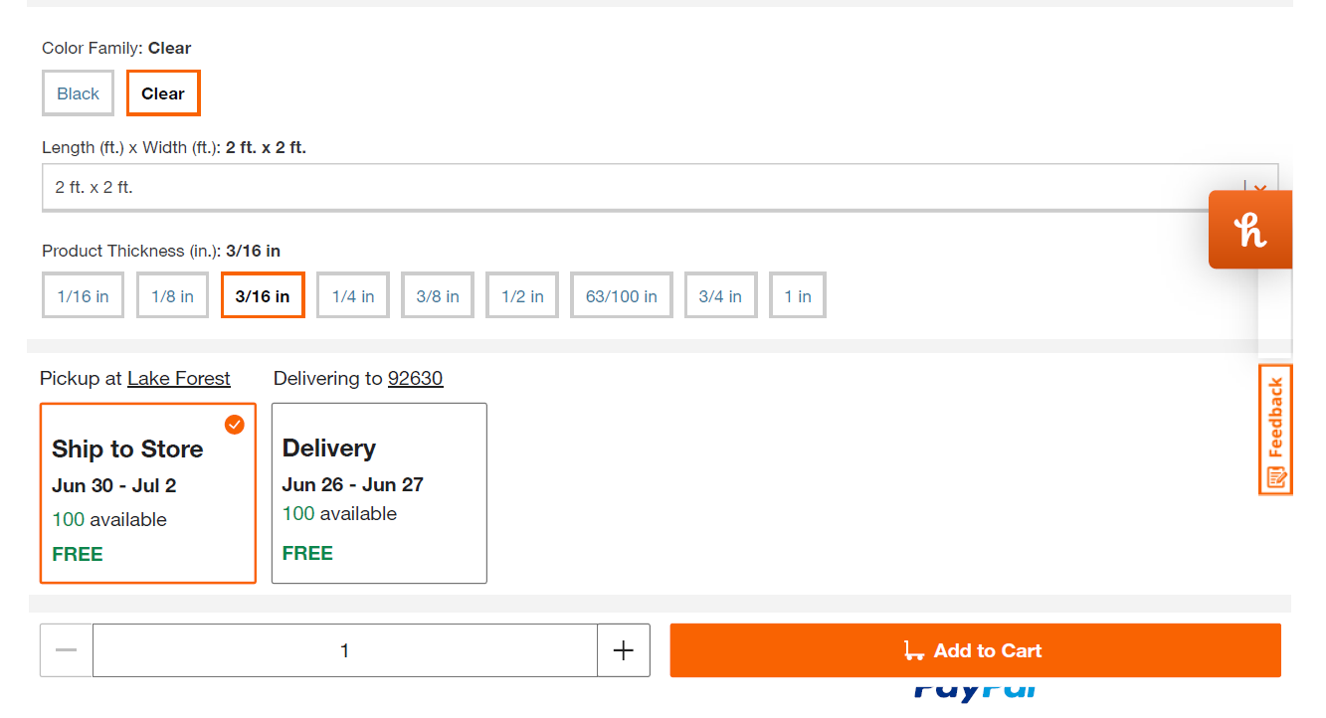
LINK

Slide 6
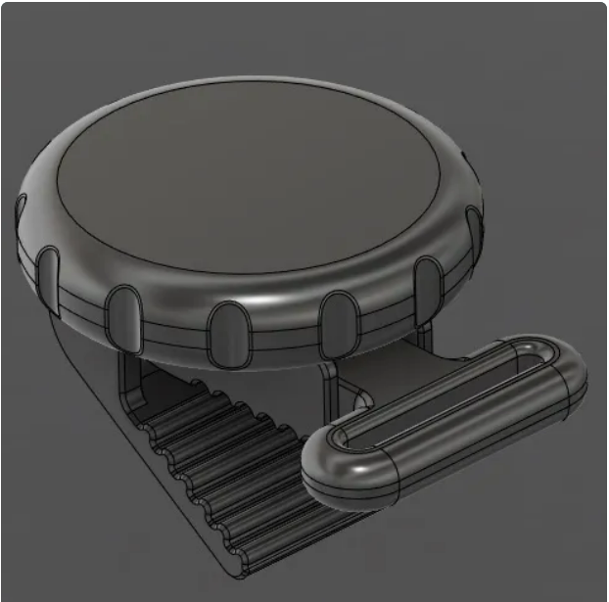
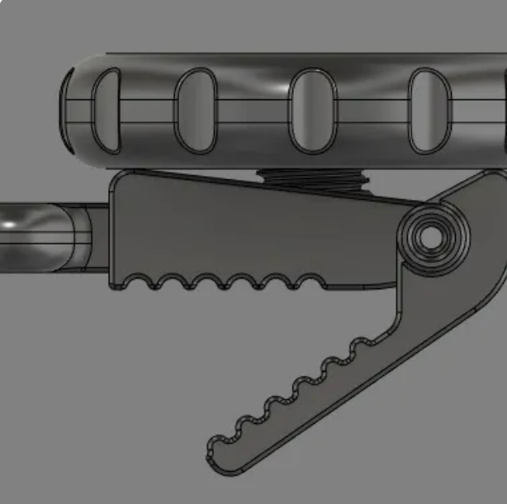
REDESIGNED PACIFIER CLIPS
Same clip strength and bite
Dial tightener (simpler) instead of latch mechanism (confusing)

Slide 7
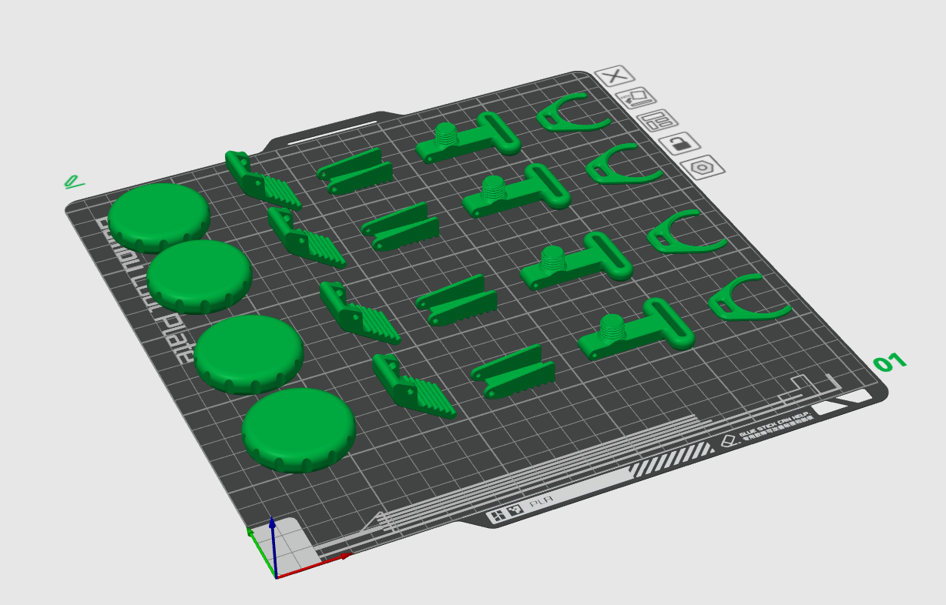
Print 4 at once (resize to our needs)

Slide 8
STRAP MATERIAL IDEAS
Shorten Current ones (replace current clip) and keep adjustable buckle
Configure it in a way where tightening only requires pulling on strap (kind of like my backpack strap - see next slide)
Elastic [adjustable] strap (see next slide)
Make very short, stretch to grab itty bitty blanket, then return to neutral position (no adjustable buckle needed)

Slide 9
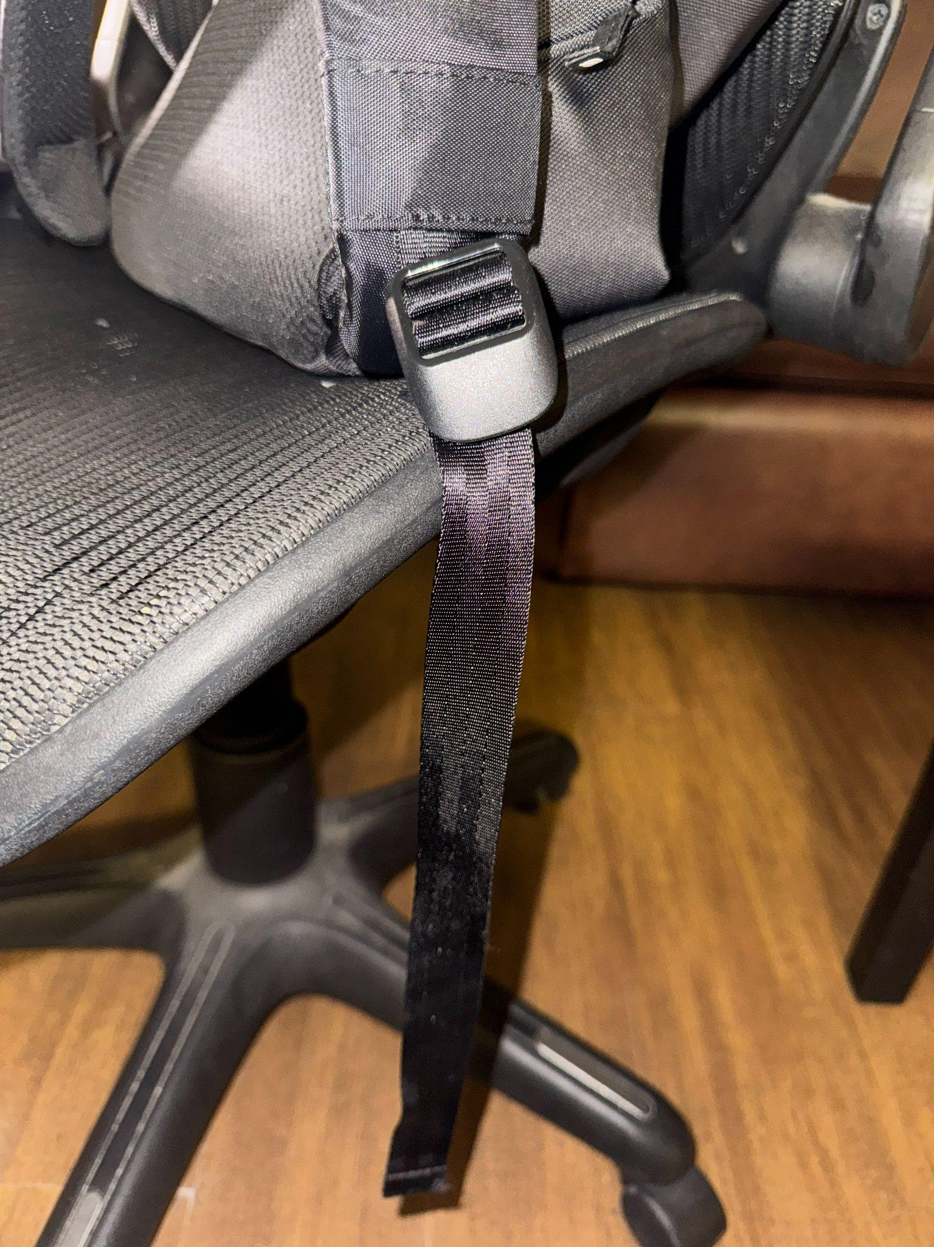
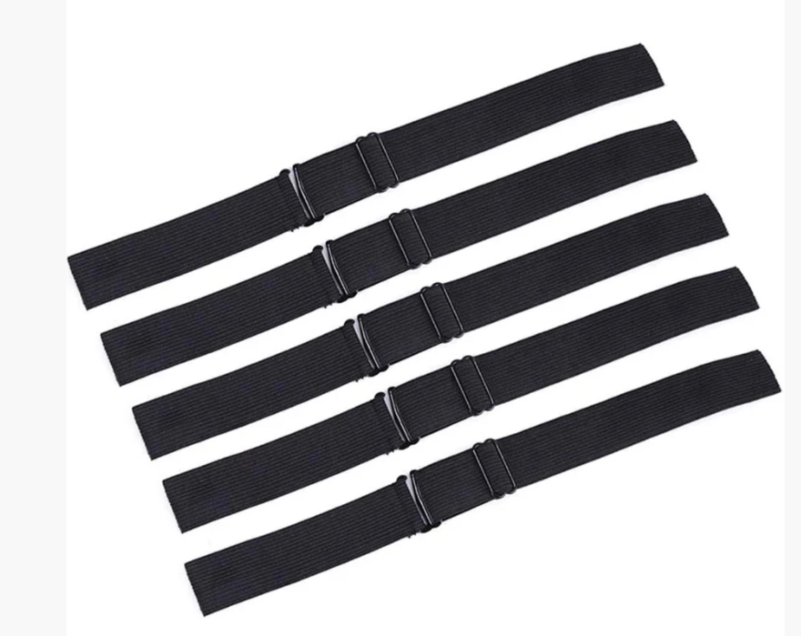
STRAP MATERIAL IDEAS CONT.

Slide 10
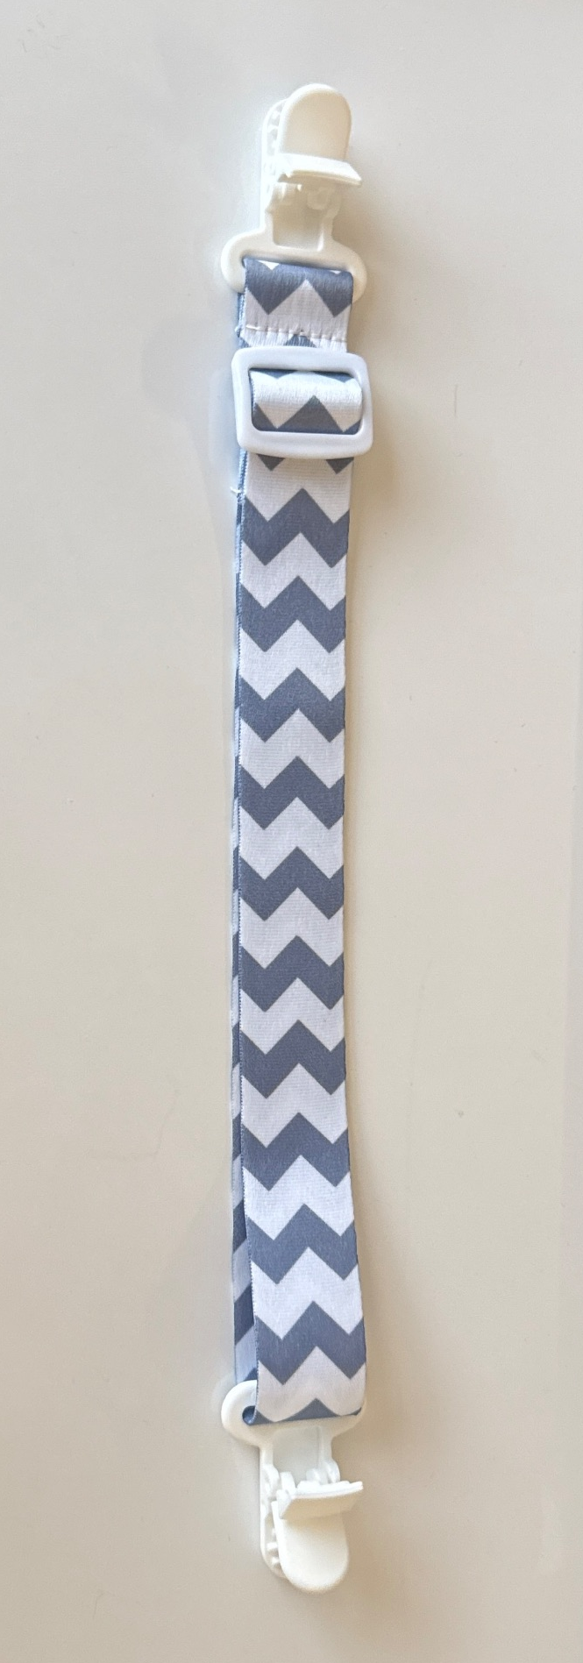
BUCKLES
This is a “ladder lock” buckle. One end of the strap is fixed, so you adjust by pulling only the free end of the strap.
This is a “tri-glide” or “3-bar slide” buckle. You can shorten or lengthen from either side.
If necessary, we can replace the 3-bar slide with a one inch ladder lock buckle: https://www.buckleguy.com/sll-1-heavy-duty-plastic-strap-adjuster-ladderlock-buckle/?srsltid=AfmBOop5bEwwWX5XZua2WuwIalcwqWYwi-KmI9Szz44lofo_MUTZw2Ff

Slide 11
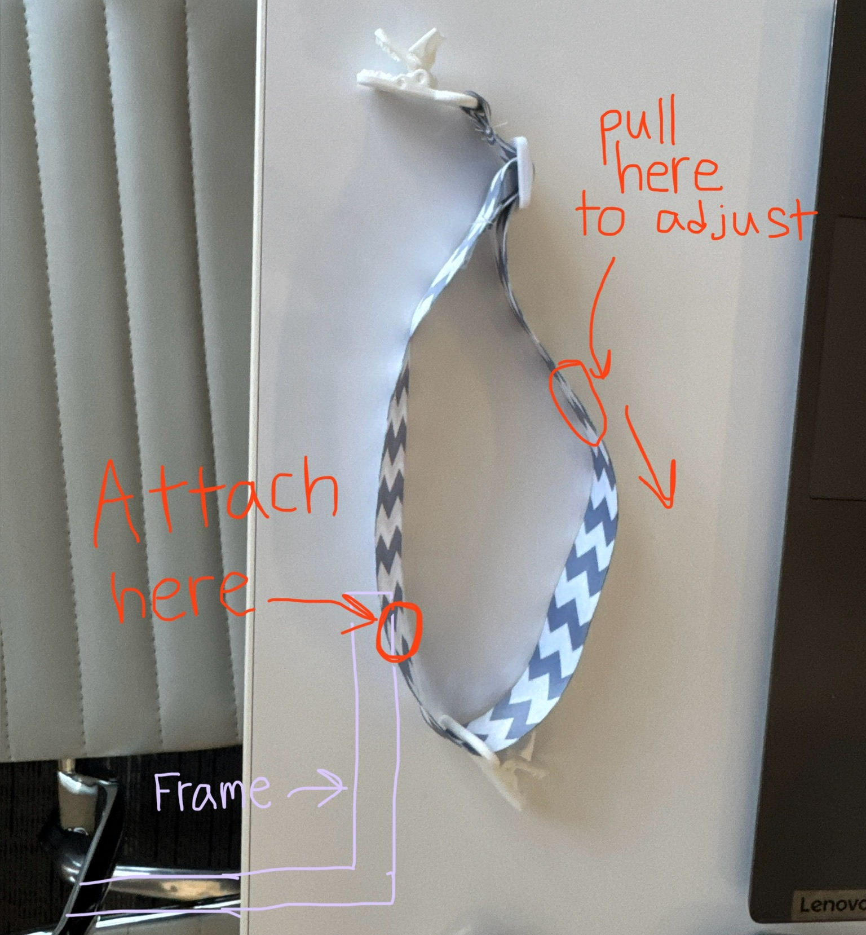
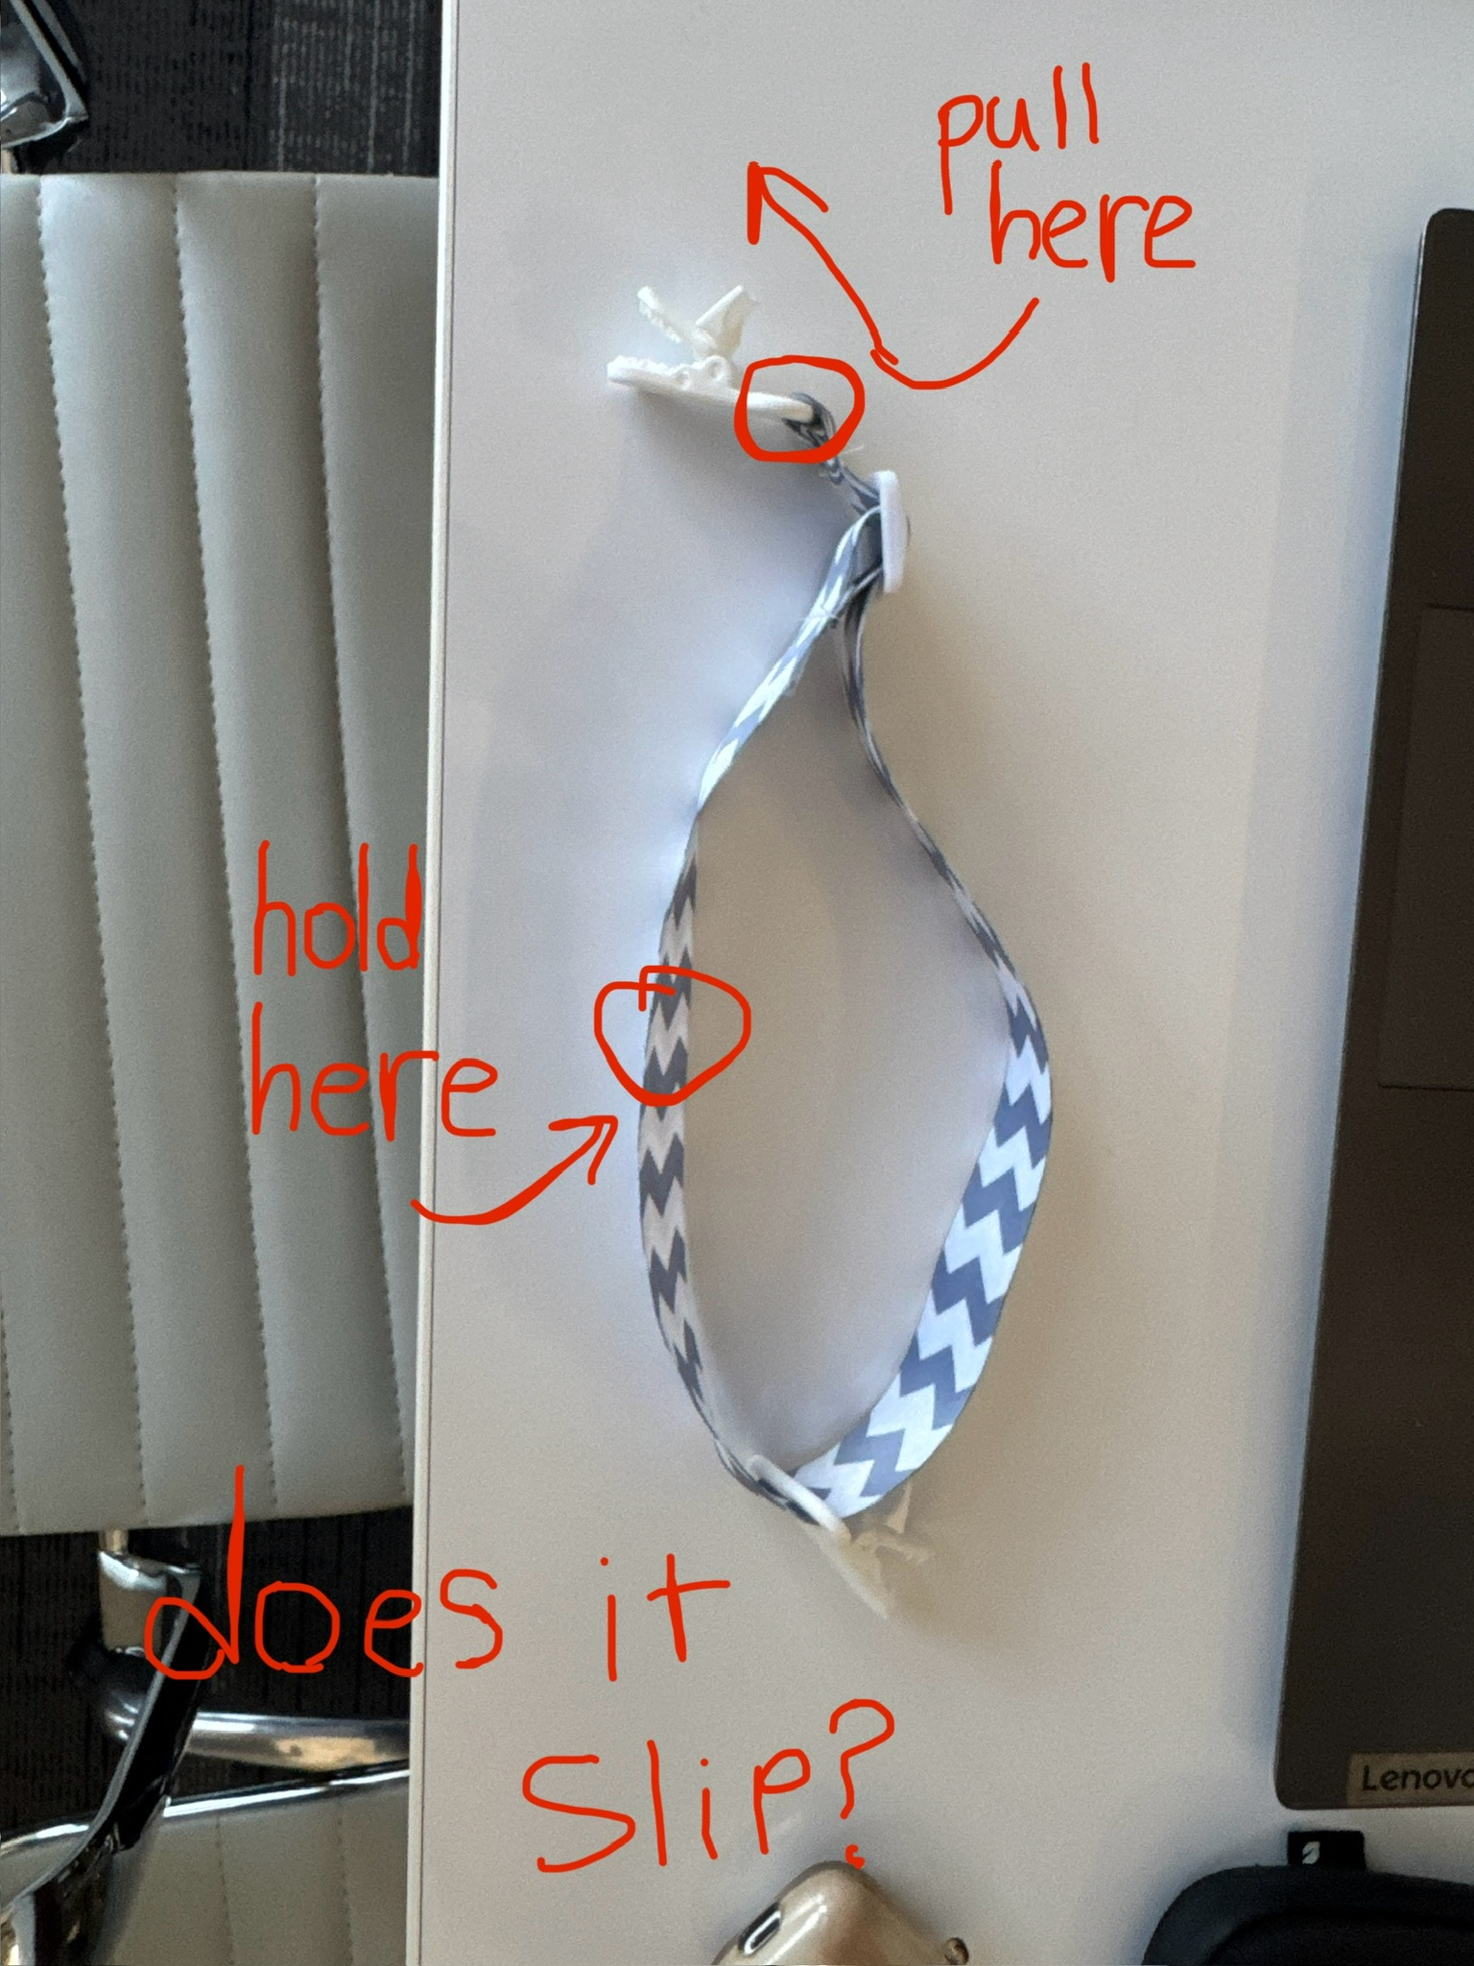
BUCKLES CONT.
If the pacifier clip straps are secure when pulled in this position,
We could probably attach them to the frame like this.

